Slide 1
Welcome to Greyhoundderby Quiz 10, produced for the Brill Punters Club, and billed as the most difficult horse racing quiz of all time.

Slide 2
Rules and Challenge
The quiz consists of 4 Picture Rounds where you can accumulate your gambling points, followed by 24 questions where you will be offered 5 possible answers and asked to gamble your points on the one you think is correct. You are allowed to gamble anything from 1% to 50% of your points on each question.
You can download an answer sheet and submit your answers at the end of the quiz.

Slide 3
Round 1
How many of the following racecourses can you identify?
You will be awarded 50 points for each course you identify, giving a maximum score of 1000 points at the end of this round.

Slide 4
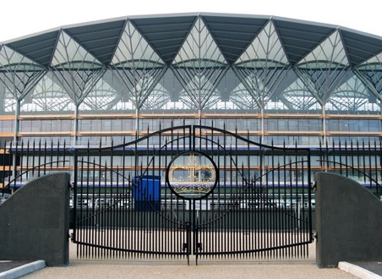
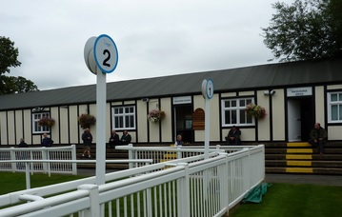
Which racecourses are pictured? 50 points for each you identify
Number 1 | Number 2

Slide 5
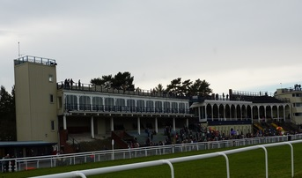
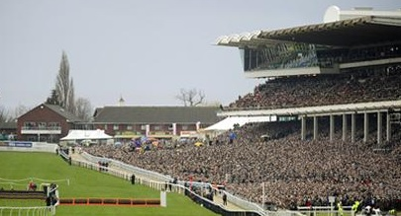
Which racecourses are pictured? 50 points for each you identify
Number 3 | Number 4

Slide 6
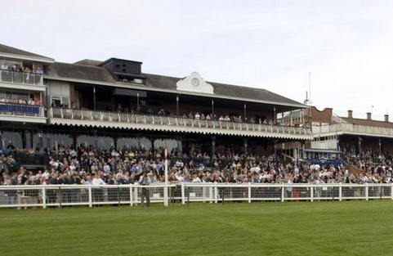
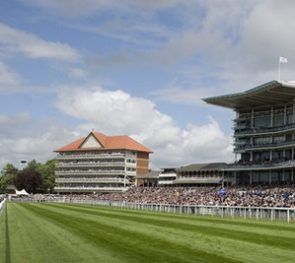
Which racecourses are pictured? 50 points for each you identify
Number 5 | Number 6

Slide 7
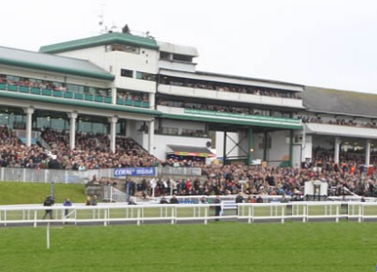
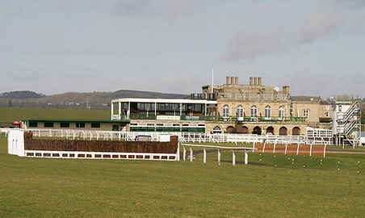
Which racecourses are pictured? 50 points for each you identify
Number 7 | Number 8

Slide 8
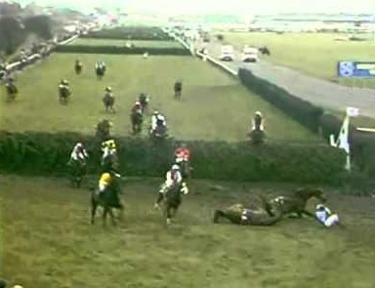
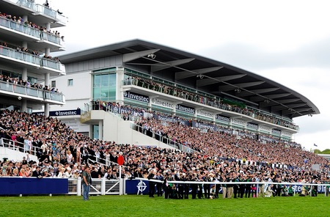
Which racecourses are pictured? 50 points for each you identify
Number 9 | Number 10

Slide 9
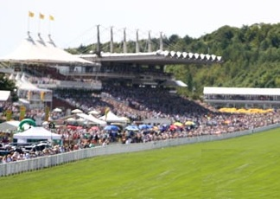
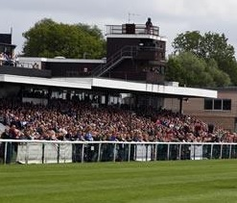
Which racecourses are pictured? 50 points for each you identify
Number 11 | Number 12

Slide 10
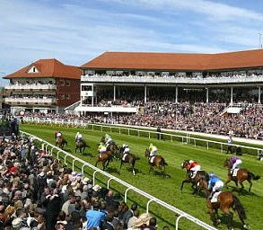
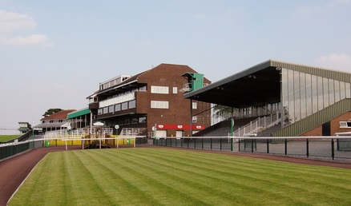
Which racecourses are pictured? 50 points for each you identify
Number 13 | Number 14

Slide 11
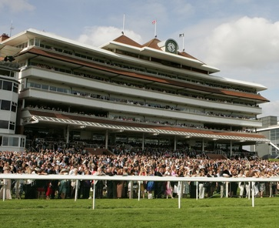
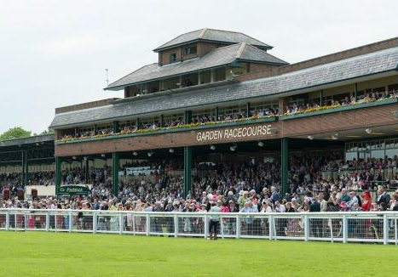
Which racecourses are pictured? 50 points for each you identify
Number 15 | Number 16

Slide 12
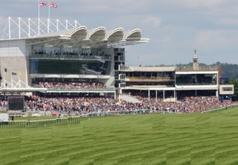
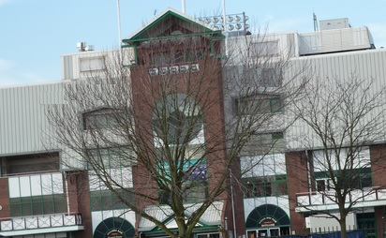
Which racecourses are pictured? 50 points for each you identify
Number 17 | Number 18

Slide 13
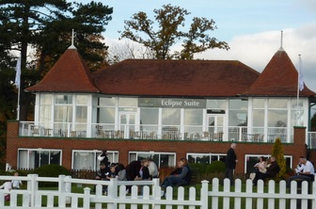
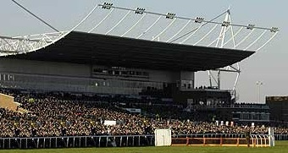
Which racecourses are pictured? 50 points for each you identify
Number 19 | Number 20

Slide 14
Name the Racecourses 50 pts each
1 |  | 11
2 |  | 12
3 |  | 13
4 |  | 14
5 |  | 15
6 |  | 16
7 |  | 17
8 |  | 18
9 |  | 19
10 |  | 20

Slide 15
Round 2
In this round there are 6 questions and, for each question, 5 answers are provided. You select the answer you think is correct and bet points on your answer. If you are very confident then you can stake up to a maximum of 50% of your current points on your answer. Less confident and you can stake anything between 1% and 50%. If you are incorrect you lose the points you stake.

Slide 16
The Grand National question
Which horse was Captain Becher riding when he fell at his now famous Brook?
A | The Duke
B | Conrad
C | Cramp
D | Seventy Four
E | None of these

Slide 17
The Bookmaker question
Where did John Banks, the bookmaker, make his first book?
A | Epsom Racecourse
B | Carntyne Greyhound stadium
C | Ayr Racecourse
D | Bogside racecourse
E | None of these

Slide 18
The Epsom Derby question
When Running Rein was disqualified after passing the post first, the first prize was £4,450. What would the equivalent amount be today?
A | £2.2 million
B | £3 million
C | £3.15 million
D | £4.45 million
E | £5.4 million

Slide 19
The betting question
I have a £1 yankee, staking a total of £11, and all 4 horses win at 5/2, 7/2, 4/1 and 5/1.
What was my total return?
A | £1100
B | £1019
C | £1019.50
D | £1019.75
E | None of these amounts

Slide 20
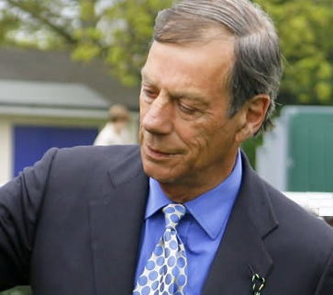
The trainer question
How many times did the trainer shown opposite win the Trainers Championship?
A | 7
B | 8
C | 9
D | 10
E | More than 10

Slide 21
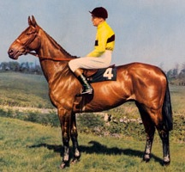
The racehorse question
What was second to the horse shown opposite when he won his final Cheltenham Gold Cup?
A | Mill House
B | Flyingbolt
C | Pendil
D | What a Myth
E | None of these

Slide 22
Round 3
How many of the following racecourse Members badges can you identify?
You will be awarded 50 points for each badge you identify, giving a maximum score of 1000 points at the end of this round.

Slide 23
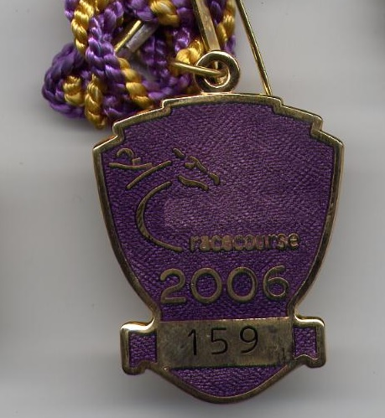
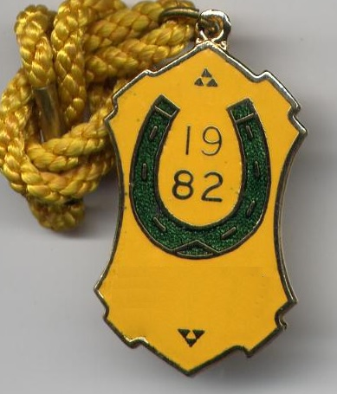
Which racecourse members badges are pictured? 50 points for each you identify
Number 1 | Number 2

Slide 24
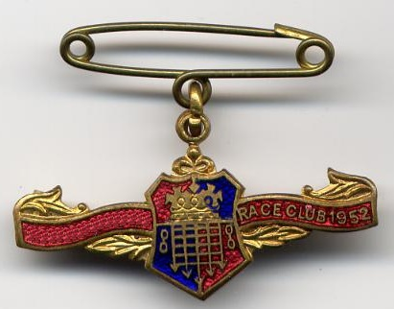
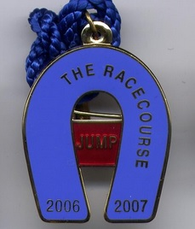
Which racecourse members badges are pictured? 50 points for each you identify
Number 3 | Number 4

Slide 25
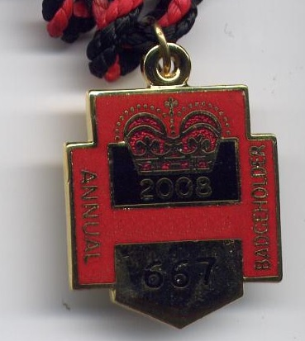
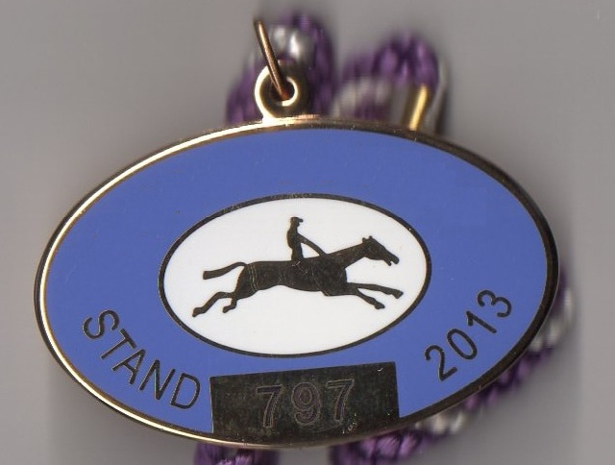
Which racecourse members badges are pictured? 50 points for each you identify
Number 5 | Number 6

Slide 26
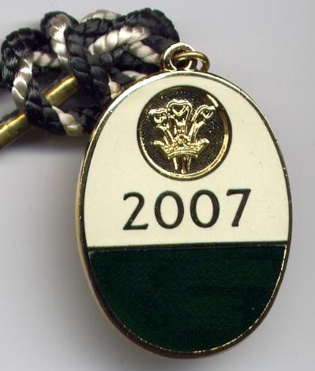
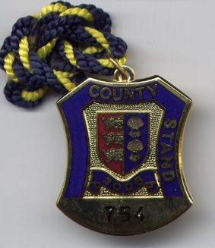
Which racecourse members badges are pictured? 50 points for each you identify
Number 7 | Number 8

Slide 27
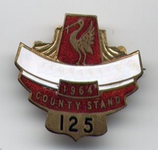
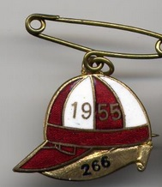
Which racecourse members badges are pictured? 50 points for each you identify
Number 9 | Number 10

Slide 28
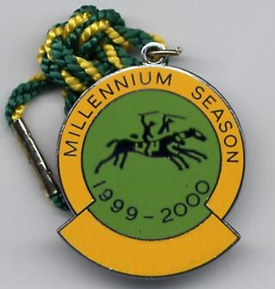
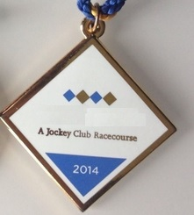
Which racecourse members badges are pictured? 50 points for each you identify
Number 11 | Number 12

Slide 29
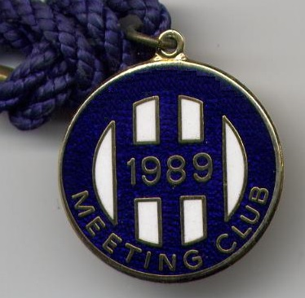
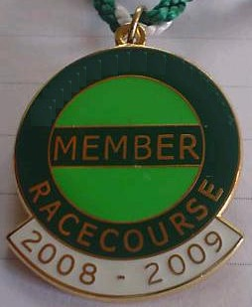
Which racecourse members badges are pictured? 50 points for each you identify
Number 13 | Number 14

Slide 30
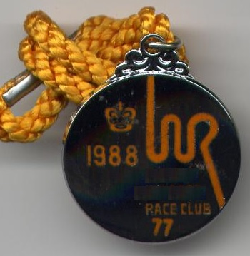
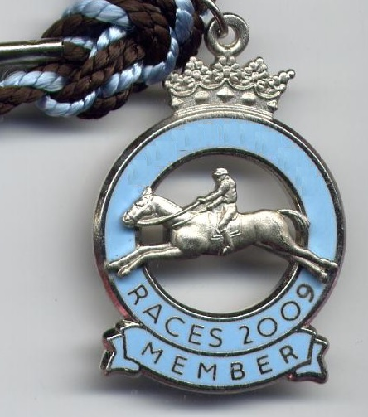
Which racecourse members badges are pictured? 50 points for each you identify
Number 15 | Number 16

Slide 31
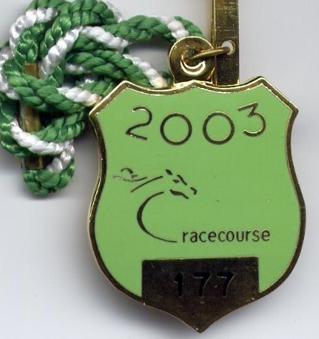
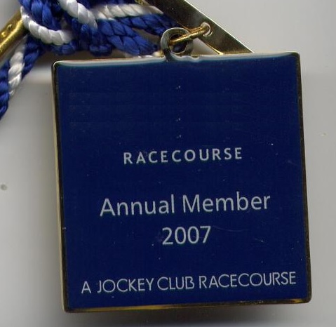
Which racecourse members badges are pictured? 50 points for each you identify
Number 17 | Number 18

Slide 32
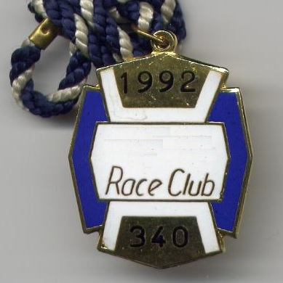
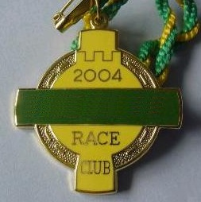
Which racecourse members badges are pictured? 50 points for each you identify
Number 19 | Number 20

Slide 33
Recognise the Members badges 50 pts each
1 |  | 11
2 |  | 12
3 |  | 13
4 |  | 14
5 |  | 15
6 |  | 16
7 |  | 17
8 |  | 18
9 |  | 19
10 |  | 20

Slide 34
Round 4
In this round there are 6 questions and, for each question, 5 answers are provided. You select the answer you think is correct and bet points on your answer. If you are very confident then you can stake up to a maximum of 50% of your current points on your answer. Less confident and you can stake anything between 1% and 50%. If you are incorrect you lose the points you stake.

Slide 35
The Grand National question
Which horse won the Grand National contested by the largest field in its history?
A | Easter Hero
B | Richmond II
C | Tipperary Tim
D | Gregalach
E | None of these

Slide 36
The Bookmaker question
Which bookmaker was known as ‘The Asparagus Kid’?
A | John Pegley
B | Mickey Fletcher
C | Bob Jacobs
D | Freddie Williams
E | None of these

Slide 37
The Epsom Derby question
Which horse won the Derby when the largest field contested the race?
A | Caractacus
B | The Marquis
C | The Knave
D | Macaroni
E | None of these

Slide 38
The betting question
I have a win double on two horses. The first wins at 85/40 and the second at 4/6. What is the smallest whole number of pounds I must invest to win a whole number of pounds?
A | £8
B | £16
C | £240
D | £24
E | None of these amounts

Slide 39
The trainer question
Between 1901 and 2014 how many trainers have won their sole Trainers Championship and the Derby in the same year?
A | 8
B | 9
C | 10
D | 11
E | More than 11

Slide 40
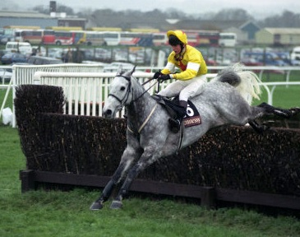
The racehorse question
What weight did the horse shown opposite carry when winning the Hennessey Gold Cup
A | 10 st 5 lbs
B | 10 st 0 lbs
C | 11 st 8 lbs
D | 11 st 12 lbs
E | None of these

Slide 41
Round 5
How many of the following jockeys can you identify?
You will be awarded 50 points for each jockey you identify, giving a maximum score of 1000 points at the end of this round.

Slide 42
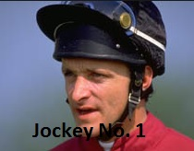
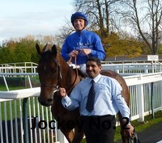
Which jockeys are pictured? 50 points for each you identify
Number 1 | Number 2

Slide 43
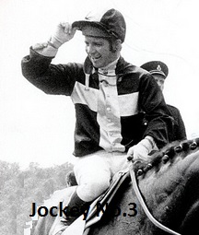
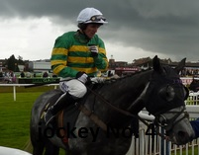
Which jockeys are pictured? 50 points for each you identify
Number 3 | Number 4

Slide 44
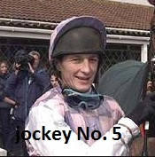
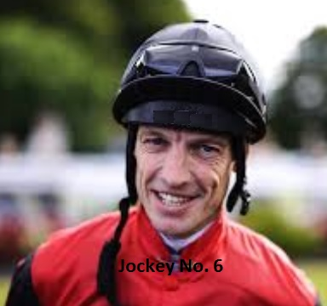
Which jockeys are pictured? 50 points for each you identify
Number 5 | Number 6

Slide 45
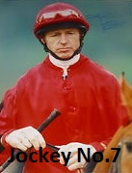
Which jockeys are pictured? 50 points for each you identify
Number 7 | Number 8

Slide 46
Which jockeys are pictured? 50 points for each you identify
Number 9 | Number 10

Slide 47
Which jockeys are pictured? 50 points for each you identify
Number 11 | Number 12

Slide 48
Which jockeys are pictured? 50 points for each you identify
Number 13 | Number 14

Slide 49
Which jockeys are pictured? 50 points for each you identify
Number 15 | Number 16

Slide 50
Which jockeys are pictured? 50 points for each you identify
Number 17 | Number 18

Slide 51
Which jockeys are pictured? 50 points for each you identify
Number 19 | Number 20

Slide 52
Round 6
In this round there are 6 questions and, for each question, 5 answers are provided. You select the answer you think is correct and bet points on your answer. If you are very confident then you can stake up to a maximum of 50% of your current points on your answer. Less confident and you can stake anything between 1% and 50%. If you are incorrect you lose the points you stake.

Slide 53
The Grand National question
How many times did Sir Piers Bengough, Her Majesty’s Representative at Royal Ascot from 1982, ride in the Grand National?
A | 1
B | 2
C | 3
D | 4
E | 0

Slide 54
The Bookmaker question
Guntrips was once advertised as London’s oldest bookmakers. Which company are they now part of?
A | Bet365
B | Betfair
C | Betfred
D | Sunderlands
E | None of these

Slide 55
The Epsom Derby question
How old was Lester Piggott when he won his first Derby?
A | 18 years 208 days
B | 18 years 209 days
C | 18 years 210 days
D | 18 years 211 days
E | None of these

Slide 56
The Betting question
I have a £5 yankee, staking a total of £55. All 4 horses win, the first 3 at 5/4, 5/2 and 3/1. I get a total return of £12,575. What was the price of my final winner?
A | Evens
B | 6/5
C | 5/6
D | 11/8
E | None of these prices

Slide 57
The trainer question
Who won the medal shown opposite for being Champion Jumps trainer?
A | Ryan Price
B | Peter Cazalet
C | Fulke Walwyn
D | Fred Rimell
E | None of these

Slide 58
The racehorse question
Which name heads this list of horses?
………. Indiana, Dilettante II, Anselmo
A | Santa Claus
B | Hotroy
C | Conbrio
D | Coralfour
E | None of these

Slide 59
Round 7
How many of the following owners colours can you identify?
You will be awarded 50 points for each set of colours you identify, giving a maximum score of 1000 points at the end of this round.

Slide 60
Round 7 How many of the following owners colours can you identify? There are 50 points for each correct answer.
No. 1 | No. 2 | No. 3 | No. 4 | No. 5
No. 6 | No. 7 | No. 8 | No. 9 | No. 10

Slide 61
Round 7 How many of the following owners colours can you identify? There are 50 points for each correct answer.
No. 11 | No. 12 | No. 13 | No. 14 | No. 15
No. 16 | No. 17 | No. 18 | No. 19 | No. 20

Slide 62
Round 8
In this round there are 6 questions and, for each question, 5 answers are provided. You select the answer you think is correct and bet points on your answer. If you are very confident then you can stake up to a maximum of 50% of your current points on your answer. Less confident and you can stake anything between 1% and 50%. If you are incorrect you lose the points you stake.

Slide 63
The Grand National question
In what year did the horse shown opposite win the Grand National?
A | 1903
B | 1908
C | 1913
D | 1918
E | None of these

Slide 64
The Bookmaker question
Which well known high street bookmaking firm was founded by Joseph Kagarlitski?
A | Corals
B | Ladbrokes
C | Stan James
D | Bet365
E | None of these

Slide 65
The Epsom Derby question
In what year did the horse shown opposite win the Derby?
A | 1928
B | 1930
C | 1932
D | 1934
E | None of these

Slide 66
The Betting question
I have a yankee and all 4 horses win at odds of 6/4, 2/1, 7/2 and 6/1. The total return is £19,681. How much did I invest in total?
A | £44
B | £33
C | £22
D | £4
E | None of these amounts

Slide 67
The Trainer question
On how many occasions, up to the end of the 2014 season, has Nicky Henderson been Champion Jumps trainer?
A | 0
B | 1
C | 2
D | 3
E | More than 3

Slide 68
The racehorse question
Which name is at the start of this list?
………….. Durham Edition, Rinus, Brown Windsor
A | West Tip
B | Bonanza Boy
C | Mr Frisk
D | Bigsun
E | None of these

Slide 69
That’s all folks.
Now complete your answer sheet and submit it for marking to
johnwslusar@gmail.com

